Slide 1

Breathing Life into Businesses: Maximum Oxygen Inc's Decade-Long Journey in IT Solutions

Slide 2

R
GPS-based Tracking Solution for Efficient Street Cleaning and Employee Management

Slide 3
Real-time GPS tracking for efficient route management
Provides live updates on location and work status
Monitors employee performance and time management
Accurate reporting of hours worked and areas covered
Comprehensive GPS Employee Tracking for Sweepers

Slide 4
Increased Productivity: Streamline routes and reduce idle time, boosting the overall efficiency of street sweepers.
Real-time Monitoring: Track employee location and progress in real-time, ensuring compliance with daily tasks.
Cost-Effective Operations: Optimize manpower allocation, reduce operational costs, and improve service delivery.
Accountability: Automatic recording of work data for accurate payroll and compliance checks.
Public Satisfaction: Enhanced visibility of municipal cleaning operations, leading to improved public perception and trust.
Why StreetSync Tracker?

Slide 5
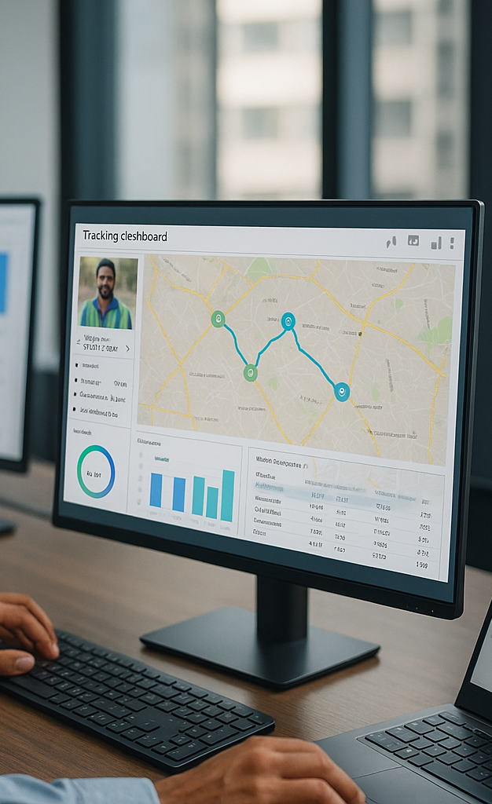
Detailed Reporting for Informed Decision-Making
Work Completion Reports: Track daily cleaning tasks and area coverage.
Performance Analysis Evaluate Efficiency metrics by ward, team or individual.
Performance Analytics: Insights into individual and team performance, helping identify improvement areas.
Compliance Reports: Ensure adherence to safety and work-hour regulations.
Time Tracking: Detailed logs of time spent at each location, ensuring optimal productivity

Slide 6
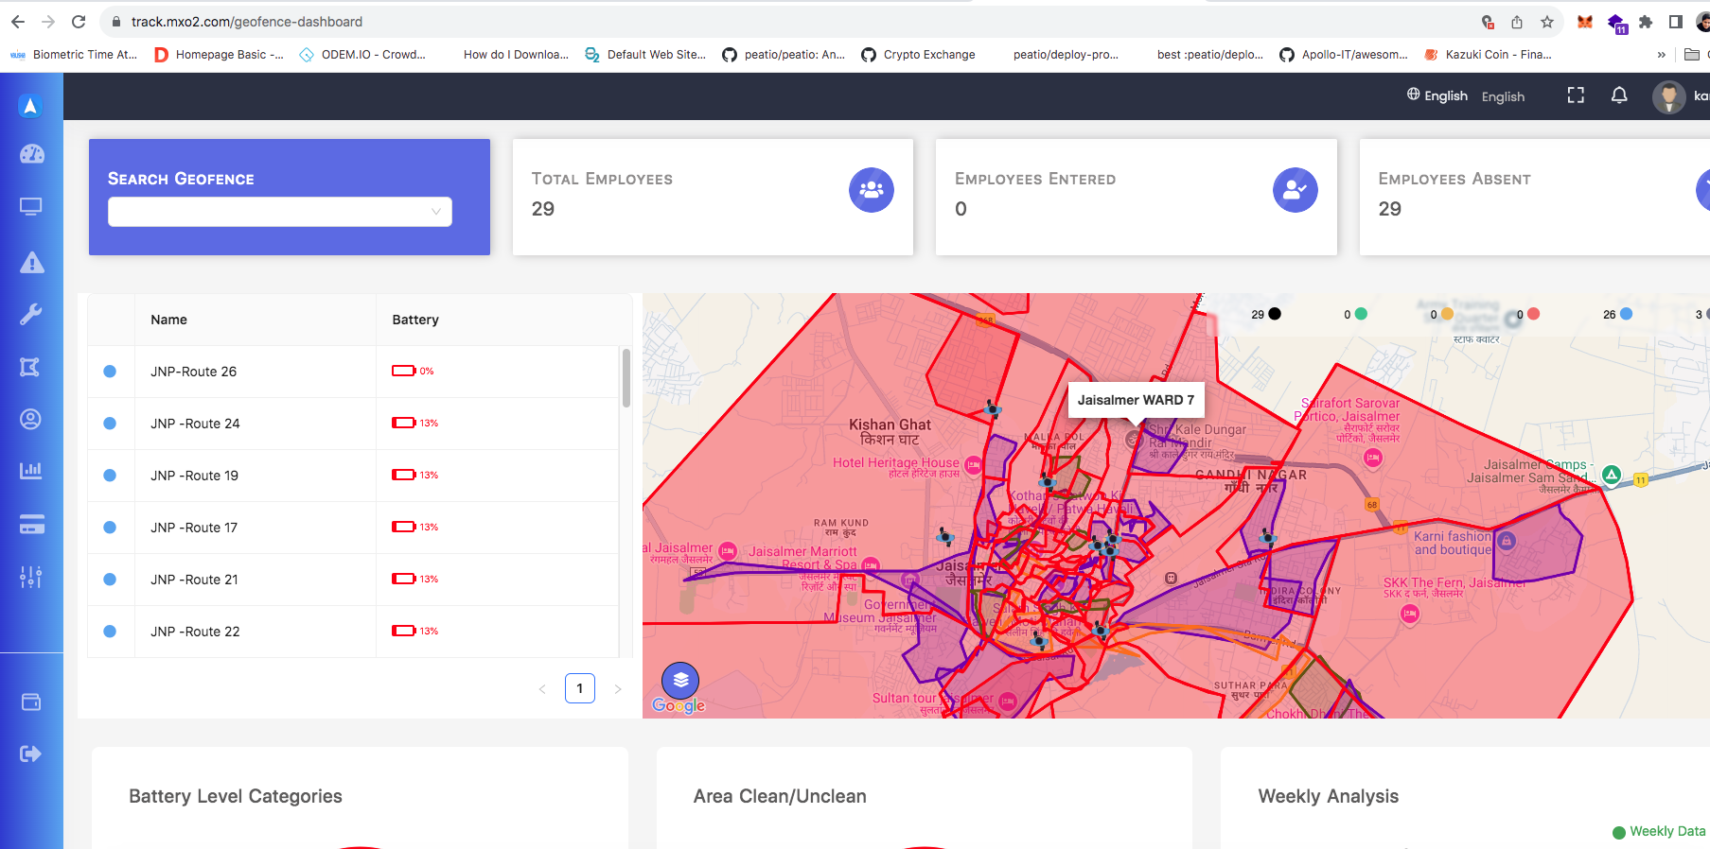
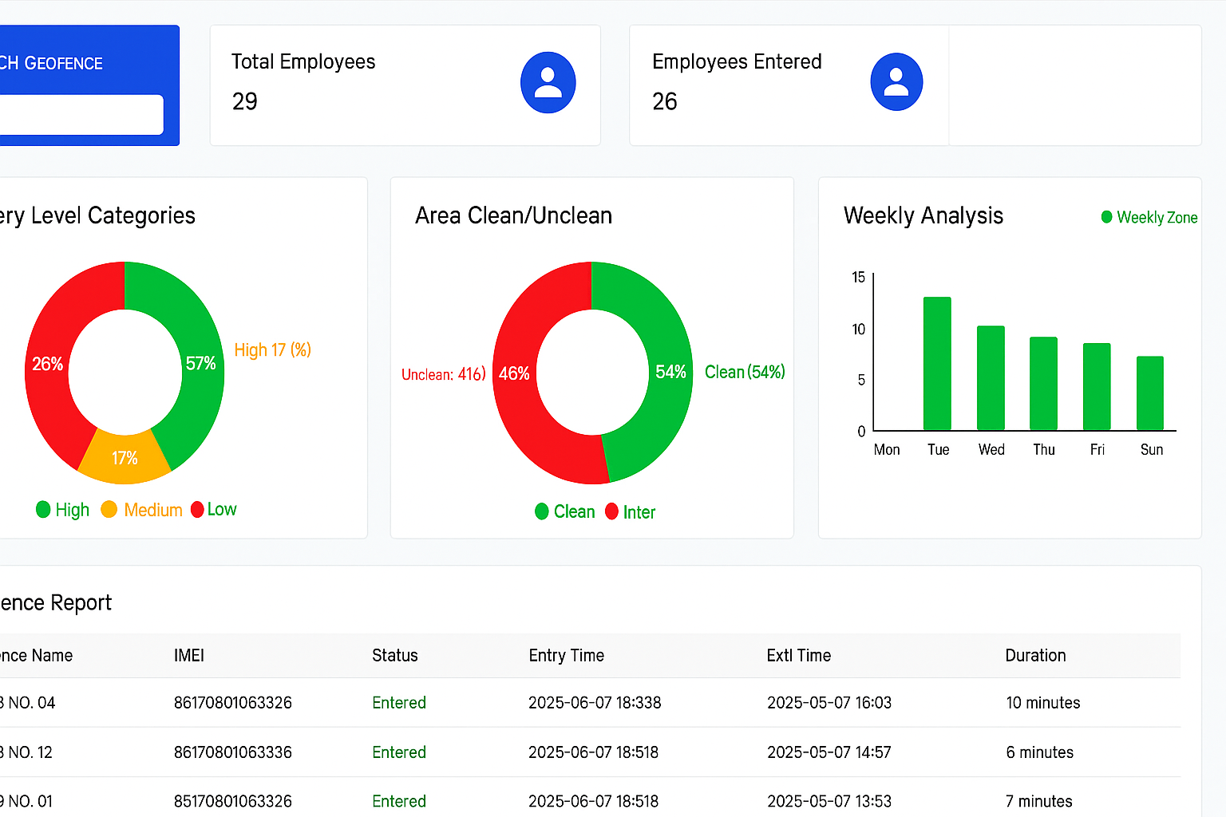
Our Solutions
Dashboard
Device Battery level
Geofencing Area
Employee In their Area
Employee live Location
Employee Total Duration in Location

Slide 7
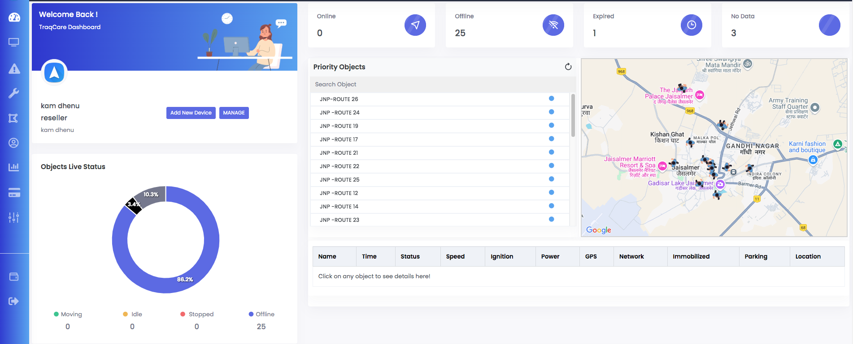
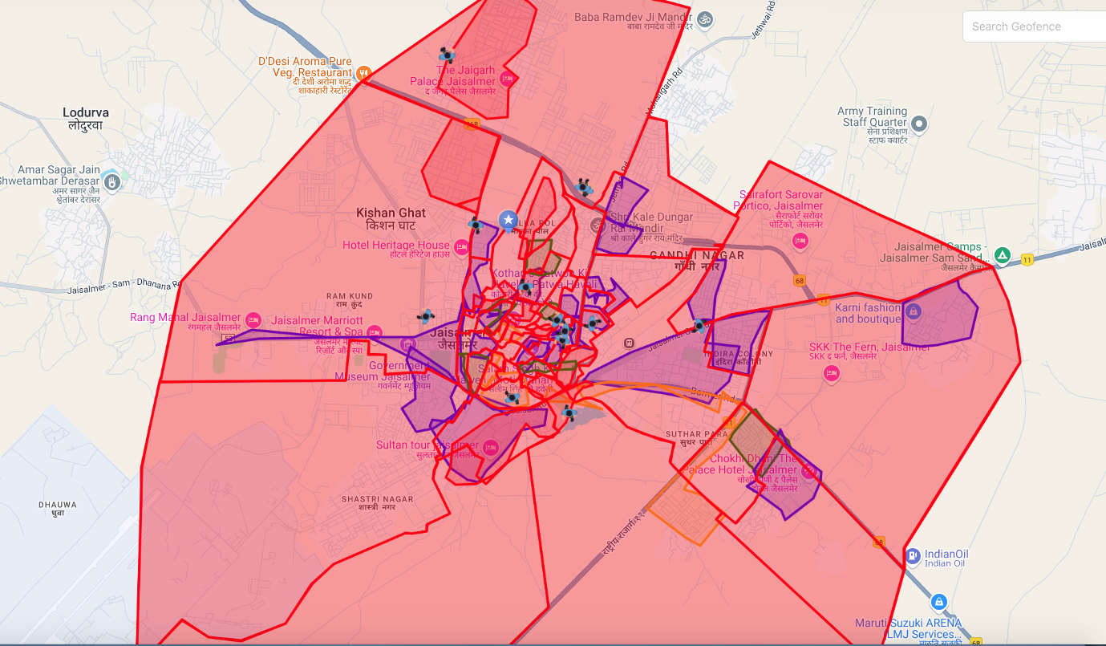
Manager Dashboard
This centralized dashboard allows office managers to:
Monitor Live Location of all field employees in real time
View Geofenced Areas to ensure employees stay within assigned zones
Track Live Activity on the Map, including route movement and stopovers
Check Device Status: Active, Idle, or Offline
Make Informed Decisions using visual maps, live status, and device analytics

Slide 8
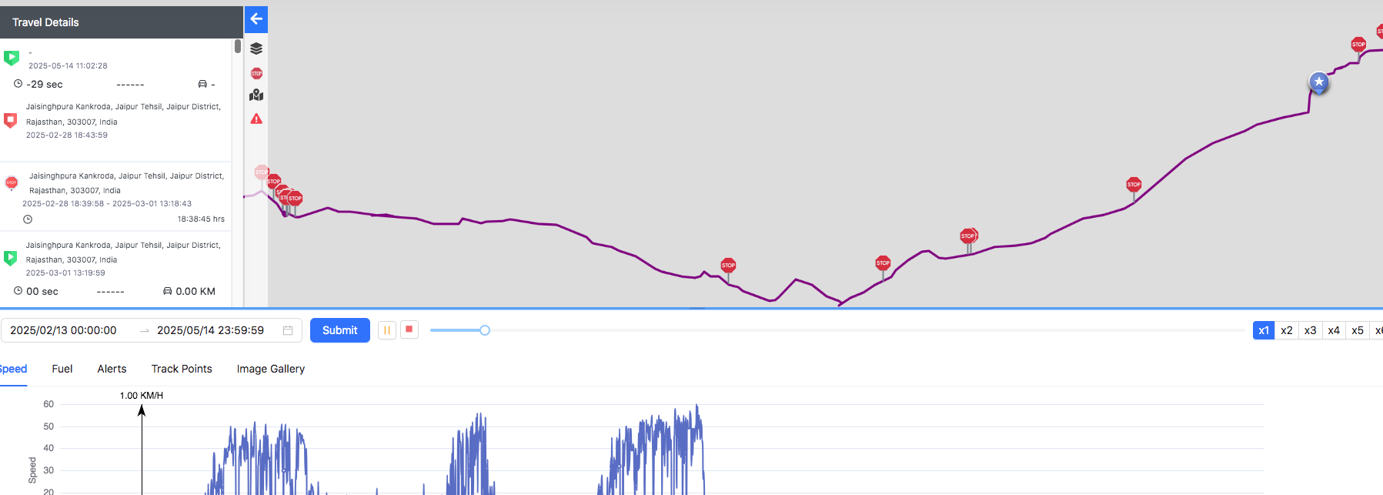
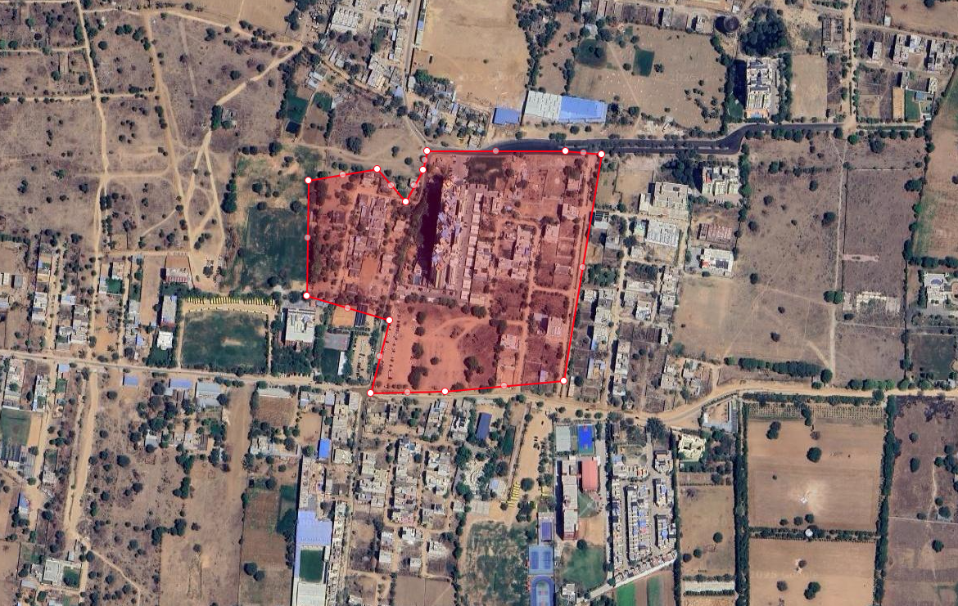
Employee Visit History
Stops • Idle Time • Movement Tracking
This section displays the detailed history of an employee's movement
including daily, weekly, and 30-day logs showing routes taken, idle
durations, and stop locations.
Geofencing Window
Satellite View • Easy Fence Creation
This section demonstrates how to define a geofence around a specific location using satellite imagery for precision and ease.

Slide 9
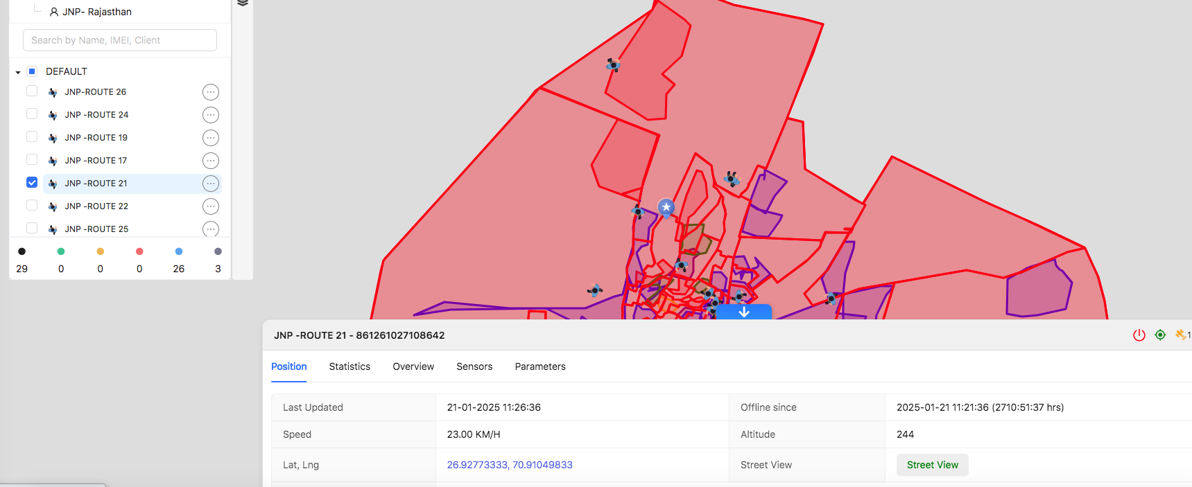
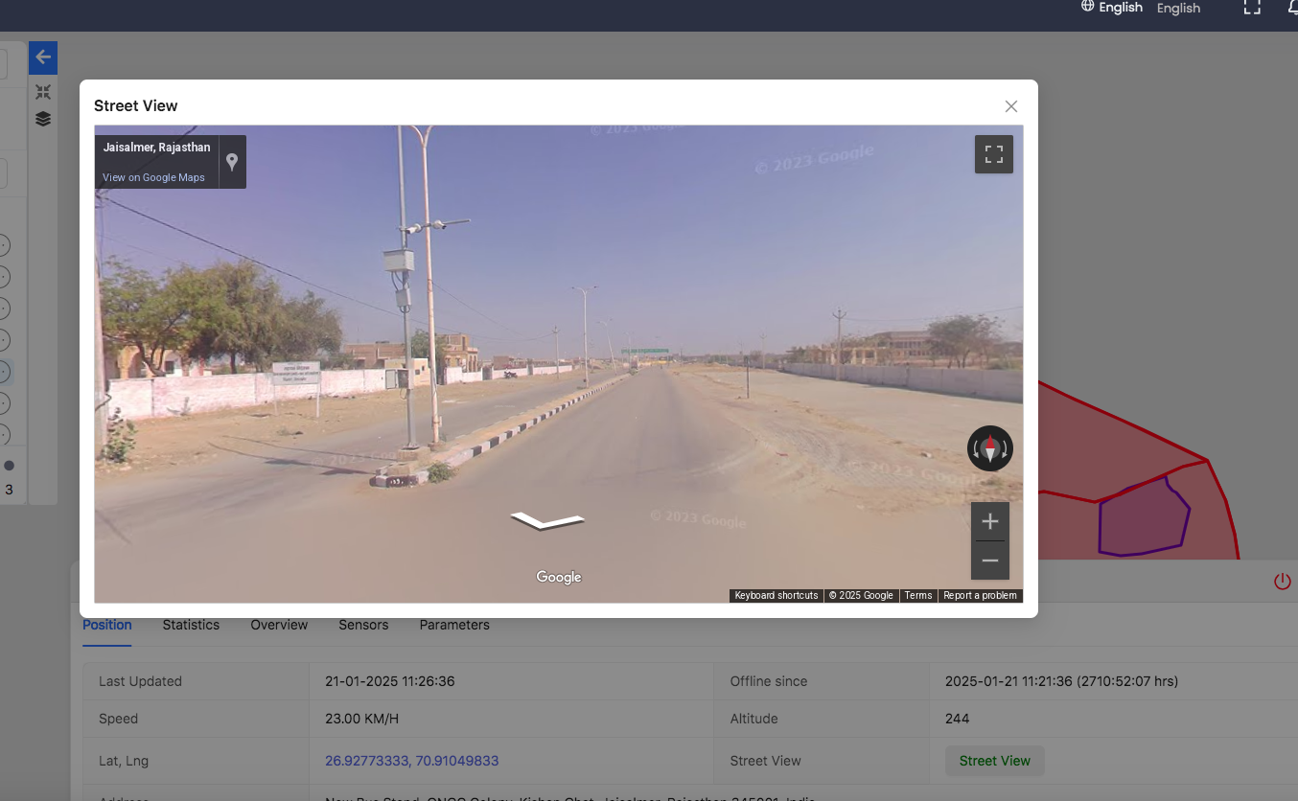
Employee Live Location
This section displays the real-time location of each device, along
with technical metrics such as battery status, speed, and sensor activity.
Street View
This section provides a real-time street-level view of the location where the device is currently active, enhancing situational awareness.

Slide 10
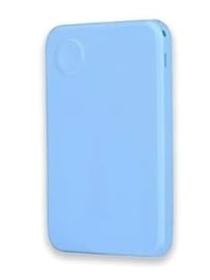
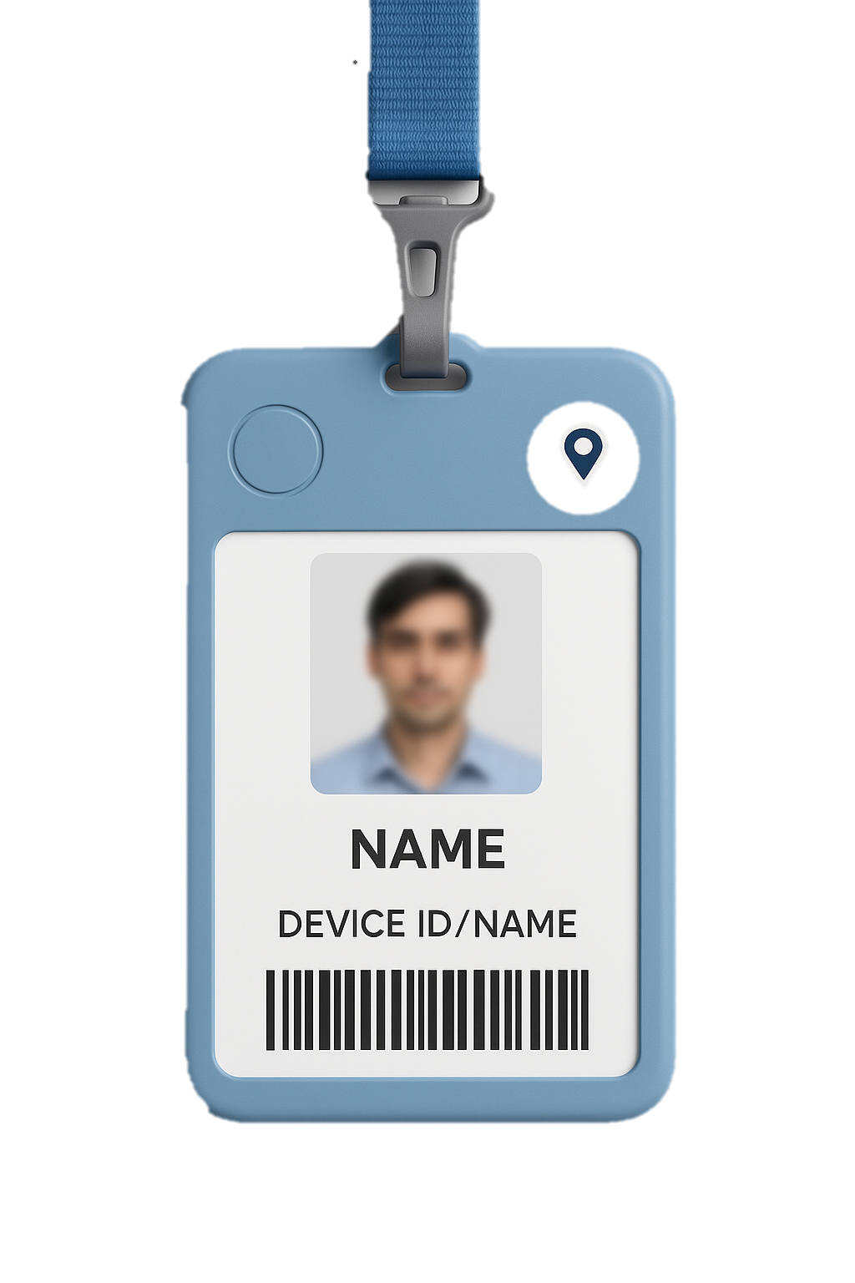
Device Features
Long-lasting Inbuilt Battery
Inbuilt Voice Monitoring Mic
Panic Alerts
Light Weight
Two-Way Calling
Asset Tracking
Real-Time Location Tracking
Emergency Response
History Playback
Geo-fence

Slide 11
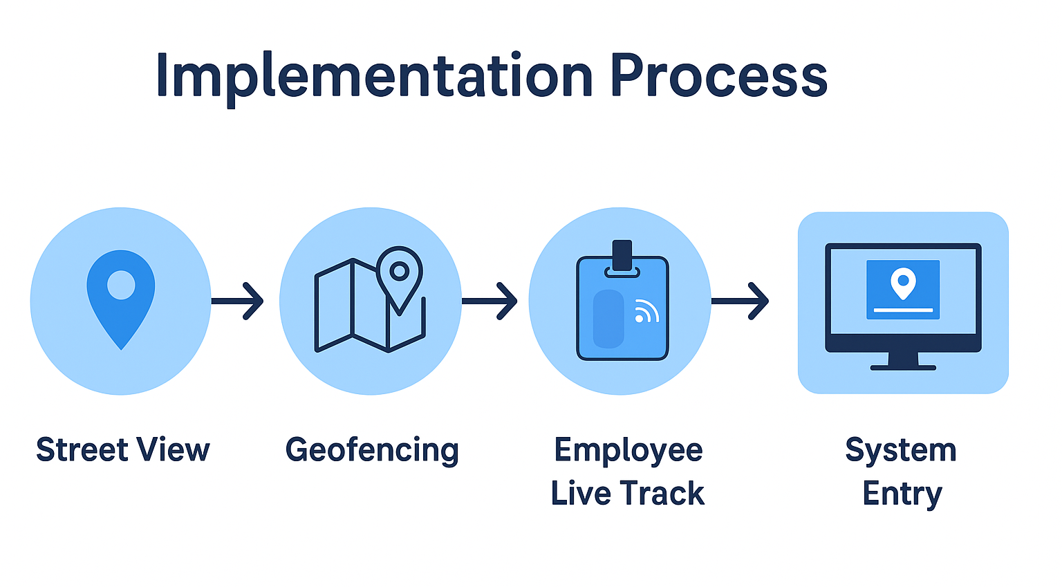

Slide 12

Seamless Integration & Scalable Support
Quick & Hassle-Free GPS Device Setup Plug-and-play installation on sweeper equipment with minimal downtime.
Intuitive Mobile App for Field Staff Designed for ease of use by non-technical employees to ensure accurate tracking and updates.
Cloud-Based Dashboard for Managers Real-time access to employee locations, geofence activity, and status alerts from any device.
24/7 Dedicated Support Ongoing technical assistance and training to resolve issues quickly and effectively.
Future-Ready & Scalable Easily expandable to support additional wards, routes, or employee roles as your municipality grows.

Slide 13



THANK YOU
+91 9829649640
sam@mxo2.com
www.mxo2.com

